Slide 1

Exploring Large Language Models for Feature Selection: A Data-centric Perspective
A Novel Approach to Machine Learning Feature Selection
Authors: Dawei Li, Zhen Tan, Huan Liu
Affiliation: School of Computing and Augmented Intelligence, Arizona State University

Slide 2
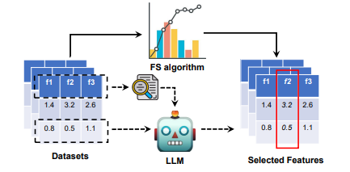
Problem Statement
Challenge: Feature selection in low-resource settings
Privacy concerns in data handling
Need for efficient methods

Slide 3
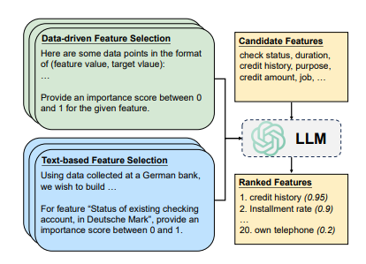
Two Core Approaches
Data-Driven Selection
Requires sample values
Statistical inference based
Traditional methodology
Text-Based SelectionMeaningful eye contact
Uses LLM's prior knowledge
Semantic associations
No sample data required

Slide 4
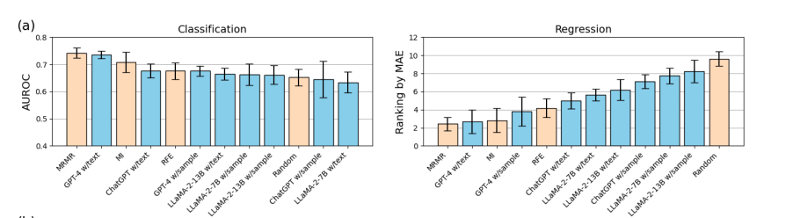
Models Evaluated
Model | Parameters
GPT-4 | ~1.7T
ChatGPT | ~175B
LLaMA-2 | 7B & 13B
Implementation Details:API-based: GPT-4, ChatGPT
Local inference: LLaMA-2 variants

Slide 5
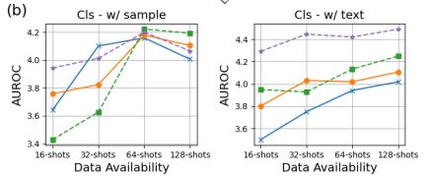
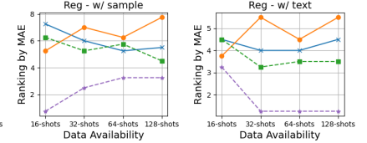
Key Findings
Primary Results:
Text-based selection outperforms data-driven approaches
Stronger correlation with model size
Better performance in low-resource settings
More stable across different data availabilities
Performance Metrics:
1. Classification: AUROC scores
2. Regression: Mean Absolute Error

Slide 6
Case Study - Cancer Survival Prediction
Method | Antolini's C↑ | IBS↓ | D-CAL↓
PriorityLasso | 0.6306 | 0.1863 | 1.8518
w/ random | 0.6516 | 0.1833 | 2.0255
w/ RAFS | 0.6566 | 0.1830 | 1.7666
RAFS Method:Retrieval-Augmented Feature Selection
Uses NCBI metadata
Handles domain-specific feature names

Slide 7
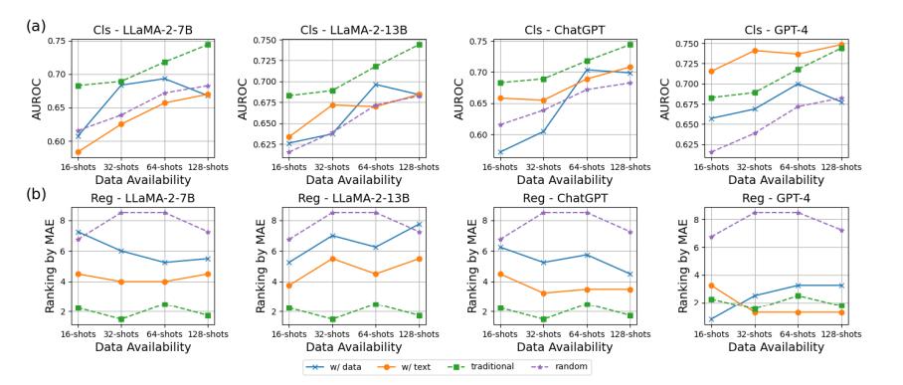
Technical Analysis
Performance Factors:
Sequence length limitations
Model size impact
Data availability effects
Processing capabilities
Scaling Laws:
Text-based scaling with model size
Data-driven performance plateau
Resource requirements

Slide 8
Advantages
Benefits:
Improved efficiency in low-resource settings
Enhanced privacy preservation
Reduced data requirements
Better semantic understanding
Robust performance across scenarios

Slide 9
Limitations
Current Challenges:
Large model size requirements
Computational costs
Potential biases in feature selection
Implementation complexity
Sequence length constraints

Slide 10
Future Directions
Research Opportunities:
Hybrid approaches combining traditional and LLM methods
Development of specialized foundation models
Agent-based LLM exploration
Enhanced privacy preservation techniques

Slide 11
Implementation Guidelines
Best Practices:
Use text-based selection for limited data scenarios
Consider RAFS for domain-specific applications
Combine with traditional methods when possible
Optimize for computational efficiency

Slide 12
Practical Applications
Domain Applications:
Healthcare data analysis
Financial services
Scientific research
Industrial applications
Privacy-sensitive domains

Slide 13
Conclusion
Key Takeaways:
LLMs offer promising feature selection capabilities
Text-based methods show superior performance
Significant potential in privacy-sensitive applications
Clear scaling benefits with larger models

Slide 14

Thank you
Satvik Atmakuri
ID: 018204979

